Slide 1
Intestinal obstruction

Slide 2
Bowel obstruction (or intestinal obstruction) is a mechanical or functional obstruction of the intestines, preventing the normal transit of the products of digestion. It can occur at any level distal to the stomach and it is a surgical emergency. The condition is often treated conservatively over a period of 2-5 days with the patient's progress regularly monitored by an assigned physician. It’s a common cause of acute abdominal pain and represents 5%-20% of acute surgical admission.

Slide 3
Epidemiology
  1% of all hospitalization
  3% of emergency surgical admissions
  More frequent in female patients because of gynecological-obstetric and pelvic surgical operations are important etiologies for post operative adhesions
  Adhesion is the most common cause of intestinal obstruction
  80% of bowel obstruction due to small bowel obstruction and the most common causes are adhesion—hernia---neoplasm while 20% due to colon obstruction and the most common cause is CR-cancer 60-70% while 30% are diverticular disease and volvulus
  Mortality rate range between 3% for simple bowel obstruction to 30% when there is strangulation or perforation
  Recurrent rate vary according to method of treatment if conservative 12% while the operation treatment recurrent rate 8-32%

Slide 4
The Questions that should be answered in patient with IO:
-Is this bowel obstruction or ileus?
-Is this a small or large bowel obstruction?
-Is this proximal or distal obstruction?
-What is the cause of this obstruction?
-Is this a complex or simple obstruction?
-How should we start investigation the patient?
-What is the immediate/ intermediate treatment plan?
-What are the indications for surgery?
-

Slide 5
Types
On the basis of presence or absence of bowel activity
Dyanamic A mechanical blockage acting as a barrier to the progression of gut contents.
Adynamic: is a paralytic or functional variety of obstruction

Slide 6
Classification of intestinal obstruction
1-Small bowel obstruction &large bowel obstruction.
2-Mechanical obstruction & functional obstruction.
3-Simple obstruction & complicated obstruction.
4-Partial obstruction& complete obstruction .
5-Acute obstruction
-Sub acute obstruction
-Acute on chronic obstruction .
-Chronic obstruction.
6-Congenital &acquired

Slide 7
Patho-physiology I
8L of isotonic fluid received by the small intestines (saliva, stomach, duodenum, pancreas and hepatobiliary )
7L absorbed
2L enter the large intestine and 200 ml excreted in the faeces
Air in the bowel results from swallowed air ( O₂ & N₂) and bacterial fermentation in the colon ( H₂, Methane & CO₂),
600 ml of flatus is released
Enteric bacteria consist of coliforms, anaerobes and strep.faecalis.
Normal intestinal mucosa has a significant immune role
Distension results from gas and/ or fluid and can exert hydrostatic pressure.
In case of BO Bacterial overgrowth can be rapid
If mucosal barrier is breached it may result in translocation of bacteria and toxins resulting in bactaeremia, septaecemia and toxaemia.

Slide 8
Patho-physiology II
Obstruction results in:
  Initial overcoming of the obstruction by increased paristalsis
  Increased intraluminal pressure by fluid and gas
  Vomiting
  sequestration of fluid into the lumen from the surrounding circulation
  Lymphatic and venous congestion resulting in oedematous tissues
  Factors 3,4,5 result in hypovolaemia and electrolyte imbalance
  Further: localised anoxia, mucosal depletion necrosis and perforation and peritonitis.
  Bacterial over growth with translocation of bacteria and it’s toxins causing bacteraemia and septicaemia.

Slide 9
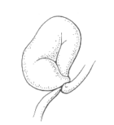
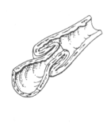
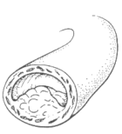
Causes of small IO:-
Extraluminal | Mural | Luminal
Adhesions Hernia Volvulus | Neoplasms Crohns TB Intussusception Congenital | F. Body Bezoars Gall stone Food Particles Ascaris

Slide 10
Etiology
  Mechanical bowel obstruction:
    Small bowel obstruction:
      Adhesion 60%
      Hernia 20%
      Neoplasm 5%
      Volvulus 5%.
      Others: IBD-GALL STONE-FOREIGN BODY-INTUSSUSCEPTION.
    Large bowel obstruction :
      Cancer 60%.
      Diverticular disease 15%.
      Volvulus 15%.
      Others: hernia –fecal impaction-inflammatory.

Slide 11
Features of obstructions
In high small bowel obstruction ,vomiting occurs early and is profuse with rapid dehydration .Distension is minimal with little evidence of fluid levels on abdominal radiography.
In low small bowel obstruction, pain is predominant with a central distention .Vomiting is delayed. Multiple central fluid level are seen in radiography.
In large bowel obstruction, distension is early and pronounced .Pain is mild and vomiting and dehydration are late .The proximal colon and caecum are distended are distended on abdominal radiography .

Slide 12
Cardinal clinical features of acute obstruction :
Abdominal pain
Distension
Vomiting
Absolute constipation .

Slide 13
Abdominal pain
Most patients who have small –bowel obstruction experience crampy abdominal pain that comes in wave .The pain is around the umbilicus.

Slide 14
Vomiting
Small bowel obstruction usually cause vomiting The vomit is green if the obstruction is in the upper small intestine and brown if it is in the lower small intestine.

Slide 15
Constipation
Constipation and inability to pass gas are signs of bowel obstruction .However ,when the bowel partially blocked a person may have stool leak and pass gas. Patient with a complete obstruction may have a bowel movement if there is stool below the obstruction.

Slide 16
Distension
With the blockage of the lower small intestine ,the epigastric area may be distinded or bloated.

Slide 17
Clinical features of strangulation
Constant pain
Tenderness with rigidity
Shock
Discoloration
Constitutional symptom

Slide 18
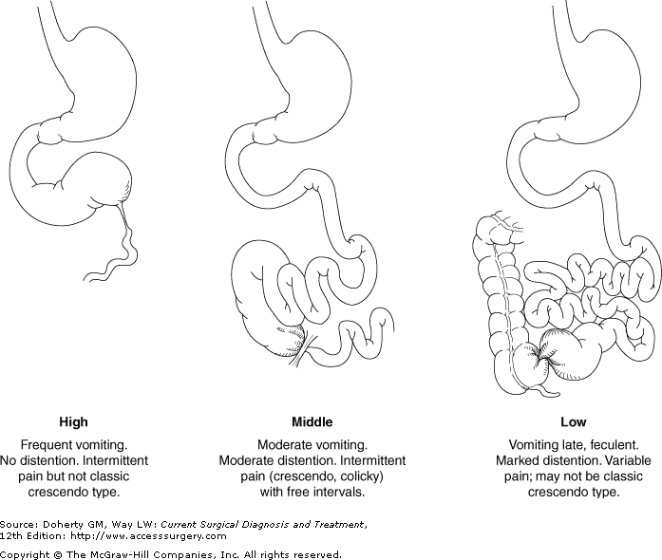

Slide 19
Clinical Findings
Examination
Others Systemic examination If deemed necessary. CNS Vascular Gynaecological musculoskeletal | Abdominal Abdominal distension and it’s pattern Hernial orifices Visible peristalsis Cecal distension Tenderness, guarding and rebound Organomegaly Bowel sounds High pitched Absent Rectal examination | General Vital signs: P, BP, RR, T, Sat dehydration Anaemia, jaundice, LN Assessment of vomitus if possible Full lung and heart examination

Slide 20
Initial Management in the ER
Resuscitate:
    Air way (O₂ 60-100%)
    IVF : Crystalloids at least 120 ml/h. (determined by estimated fluid loss and cardiac function).
NPO.
Decompress with Naso-gastric tube and secure in position
Insert a urinary catheter (hourly urinary measurements) and start a fluid input / output chart
Intravenous antibiotics (no clear evidence)
If concerns exist about fluid overloading a central line should be inserted
Follow-up lab results and correction of electrolyte imbalance
“Never let the sun set or rise on an
obstructed bowel ”

Slide 21
How to initially investigate your patient
Lab:
    CBC (leukocytosis, anaemia, hematocrit, platelets)
    Clotting profile
    Arterial blood gasses
    U& Crt, Na, K, Amylase, LFT and glucose, LDH
    Group and save (x-match if needed)
    Optional (ESR, CRP, Hepatitis profile
Radilogical:
    Plain x-rays
    USS ( free fluid, masses, mucosal folds, pattern of peristalsis, Doppler of mesenteric vasculature, solid organs)
    CT, MRI, Contrast studies……
    ECG and other investigations for co-morbid factors

Slide 22
XRAY
Diagnostic in 50 %
CXR : superior to erect abd X ray for pneumo peritoneum
Abdo X ray : Changes appear in 3-5 hrs if complete obstruction and take days if incomplete obstruction
High grade SBO : > 3.6 cm diameter of loops ; 2.5 times more in number ; air fluid levels > 2 ; wider than 2.5 cm and differing in height >2 cm
String of beads sign : small bubbles of gas trapped in rows between valvulae conniventes . Diagnostic of SBO (sometimes also in IBD and Ileus)
Coffee bean sign: closed loop obstr where the arms of the loop dilated with gas separated by thick intestinal wall
Pseudo tumor sign : closed loop fill with fluid looks like soft tissue mass

Slide 23
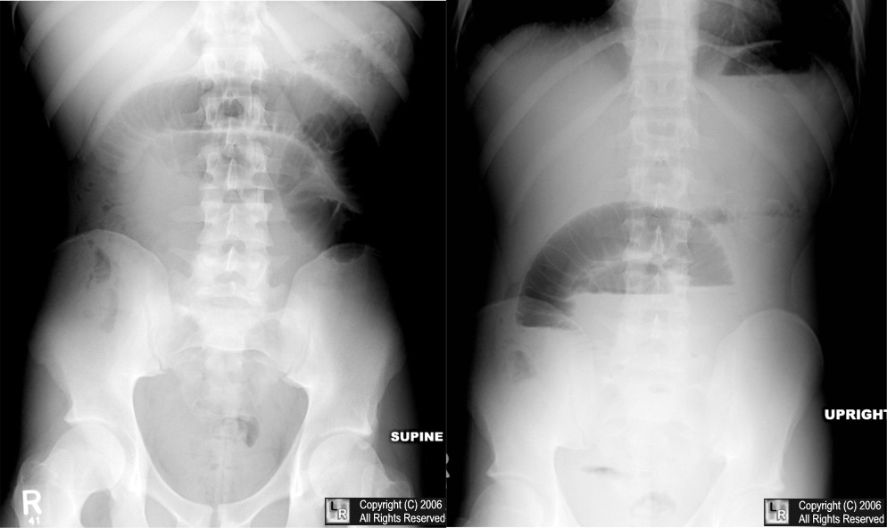
SBO

Slide 24
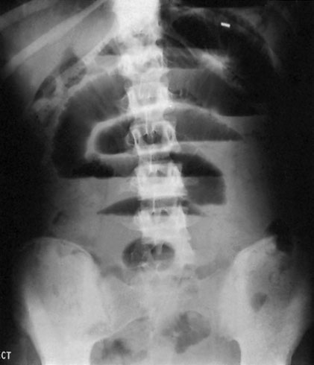
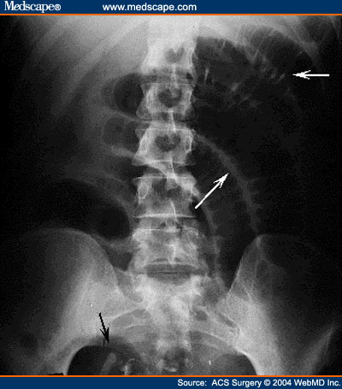
Figure 3. Lateral decubitus view of the abdomen, showing air-fluid levels consistent with intestinal obstruction (arrows).
Fluid levels with gas above; ‘stepladder pattern’. Ileal obstruction by adhesions; patient erect.
Supine radiograph from a patient with complete small bowel obstruction shows distended small bowel loops in the central abdomen with prominent valvulae conniventes (small white arrow)
Notes:
Small bowel: approximately 2.5–3 cm in diameter.
Large bowel: app 6.3cm

Slide 25
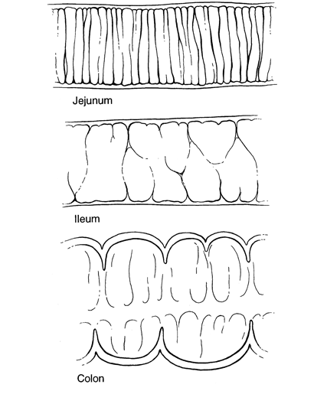

Slide 26
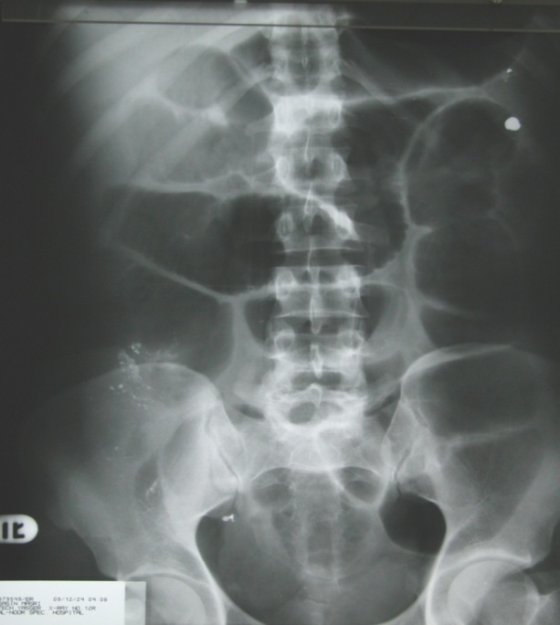
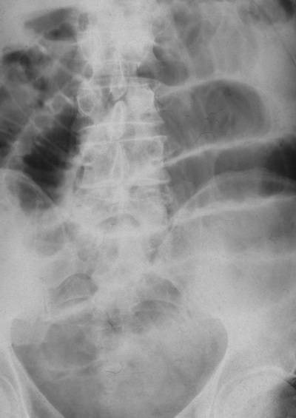
The Difference between small and large bowel obstruction
Small Bowel | Large bowel
Central ( diameter 3 cm max) Vulvulae coniventae Ileum: may appear tubeless | Peripheral ( diameter 6 cm max) Presence of haustration
Notes:
The upper limit of normal diameter of the bowel is generally accepted as 3cm for the small bowel, 6cm for the colon and 9cm for the caecum (3/6/9 rule).

Slide 27
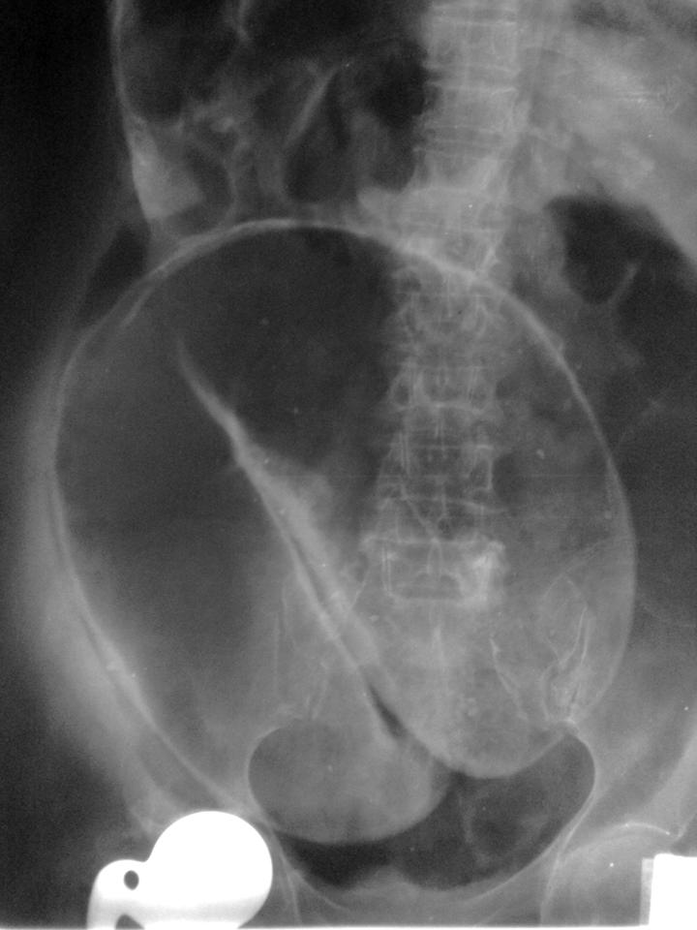
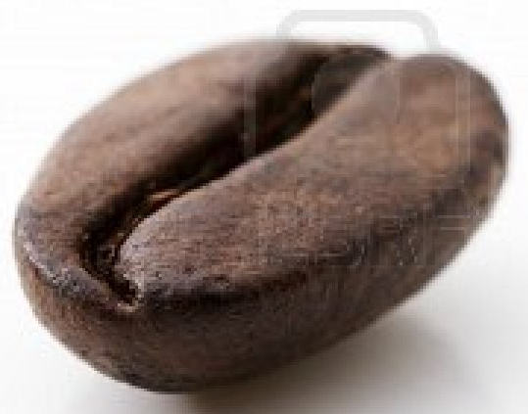
Coffee bean sign

Slide 28
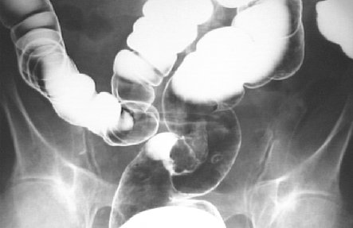

Slide 29
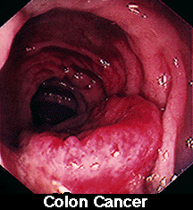

Slide 30
 | LARGEBOWEL | SMALL BOWEL
Haustra | present | Absent
Number of loops | Few | Many
Valvulae conniventes | absent | Present in jejunum
Distribution of loops | Peripheral | central
Radius of curvature of loops | Large | Small
Diameter | 5 cm | 3-5 cm
Solid feces | + | -

Slide 31
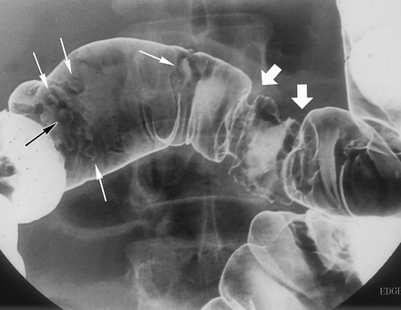
BARIUM
Water soluble contrast gets diluted
Poor mucosal detail
No therapeutic effect in SBO
Follow through : 500 ml of 42 % barium , fluroscopic radiographs at 15-30 min interval till ileo cecal valve. When barium reaches cecum put a rectal tube and insufflate air to distend the rt colon and distal iluem
Enteroclysis: duodenal intubation , 30-40% barium infusion at 60-90 ml /min
Double contrast enteroclysis:
followed by infusion of
air / methyl cellulose

Slide 32
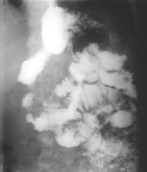
Role of barium gastrografin studies
As: follow through, enema
Limited use in the acute setting
Gastrografin is used in acute abdomen but is diluted
Useful in recurrent and chronic obstruction
May able to define the level and mural causes.
Can be used to distinguish adynamic and mechanical obstruction
Barium should not be used in
a patient with peritonitis

Slide 33
USG
When CT not available
Operator dependent modality
Obstruction : lumen > 3 cm ; length > 10 cm ; distal seg shows to and fro or whirling motion ( differentiates from ileus )
Cause can be detected
Severity : free fluid + ; aperistalsis ; bowel wall thickening > 3 mm ( sugg infarction )

Slide 34
Role of CT
Used with iv contrast, oral and rectal contrast (triple contrast).
Able to demonstrate abnormality in the bowel wall, mesentery, mesenteric vessels and peritoneum.
It can define:
  the level of obstruction
  The degree of obstruction
  The cause: volvulus, hernia, luminal and mural causes
  The degree of ischaemia
  Free fluid and gas
Ensure: patient vitally stable with no renal failure and no previous alergy to iodine
Figure: Axial computed tomography scan showing dilated, contrast-filled loops of bowel on the patient’s left (yellow arrows), with decompressed distal small bowel on the patient’s right (red arrows). The cause of obstruction, an incarcerated umbilical hernia, can also be seen (green arrow), with proximally dilated bowel entering the hernia and decompressed bowel exiting the hernia.
Source: Jackson, PG. & Raiji M., Evaluation and Management of Intestinal Obstruction, January 2011, American Academy of Family Physicians (AAFP), 83: 2 (160-164)

Slide 35
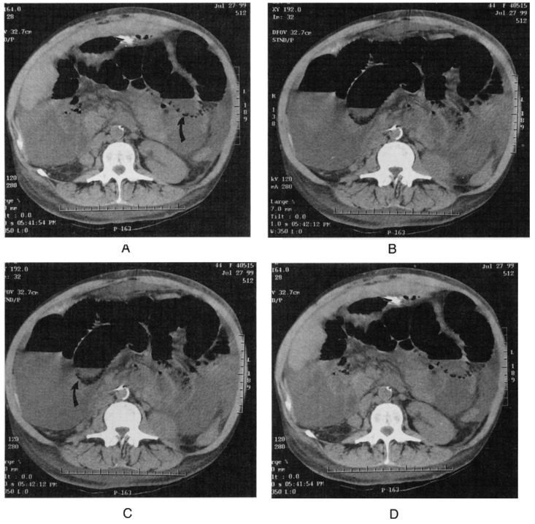

Slide 36
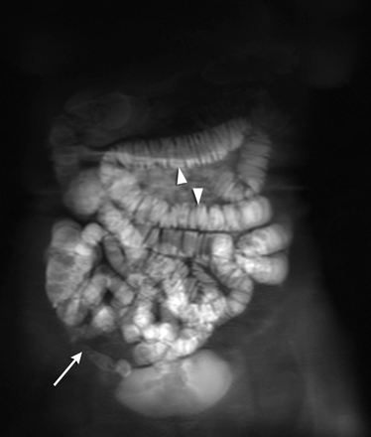
MR ENTEROCYLSIS
Can detect extra luminal patho and detailed info about the small bowel wall.
And does not use ionised radiation

Slide 37
Initial Management in the ER
Resuscitate:
    Air way (O₂ 60-100%)
    Insert 2 lines if necessary
    IVF : Crytloids at least 120 ml/h. (determined by estimated fluid loss and cardiac function). Add K⁺ at 1mmmol/kg
Draw blood for lab investigations
Inform a senior member in the team.
NPO.
Decompress with Naso-gastric tube and secure in position
Insert a urinary catheter (hourly urinary measurements) and start a fluid input / output chart
Intravenous antibiotics (no clear evidence)
If concerns exist about fluid overloading a central line should be inserted
Follow-up lab results and correction of electrolyte imbalance
The patient should be nursed in intermediate care
Rectal tubes should only be used in Sigmoid volvulus.

Slide 38
INDICATIONS FOR SURGERY
Absolute
  Generalised peritonitis
  Localised peritonitis
  Visceral perforation
  Irreducible hernia
Relative
  Palpable mass lesion
  'Virgin' abdomen
  Failure to improve
Trial of conservatism
  Incomplete obstruction
  Previous surgery
  Advanced malignancy
  Diagnostic doubt - possible ileus
Source: http: Surgical Tutor.co.uk

Slide 39
Ileus
Associated with the following conditions:
    Postoperative and bowel resection
    Intraperitoneal infection or inflammation
    Ischemia
    Extra-abdominal: Chest infection, Myocardia infarction
    Endocrine: hypothyroidism, diabetes
    Spinal and pelvic fractures
    Retro-peritoneal haematoma
    Metabolic abnormalities:
        Hypokalaemia
        Hyponatremia
        Uraemia
        Hypomagnesemia
    Bed ridden
    Drug induced: morphine, tricyclic antidepressants

Slide 40
Acute Mesenteric Occlusion
Acute ischemic of mesenteric vessel. Commonly SMA
Causes: AF, mural thrombosis, atheromatous plaque from aortic aneurysm and valave vegetation from endocarditis
Features: -Sudden onset of severe abd. pain in pt with AF and atherosclerosis
-Persistent vomiting and defecation then passage of altered blood
-Hypovolumic shock
Investigations: - Neutrophil leukocytosis
- Abd Xray: Absence of gas in thickened small intestines
Treatment: - Anti-coagulant
- Embolectomy
- Revascularization
- Colectomy

Slide 41

PSEUDO-OBSTRUCTION
Obstruction usually colon- occur in the absence of mechanical cause or acute intra-abdominal disease.
Associated with a variety of syndromes in which there is underlying neuropathy and/or a range of other factors
IDIOPATHIC | SEPTICAEMIA
Metabolic | Retroperitoneal irritation
Severe trauma at lumbar area | Drugs
Shock | Secondary GI involvement

Slide 42
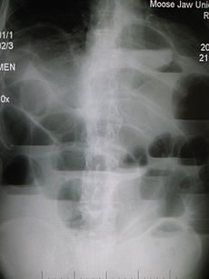
Upright abdominal X-ray demonstrating a small bowel obstruction. Note multiple air fluid levels.

Slide 43
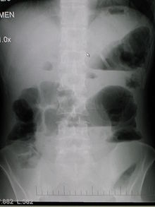
Upright abdominal X-ray of a patient with a large bowel obstruction showing multiple air fluid levels and dilated loops of bowel.

Slide 44
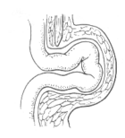
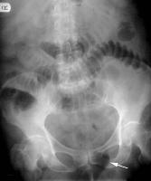
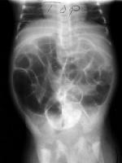
Hernia

Slide 45
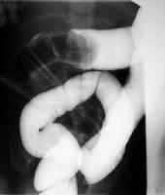
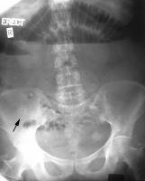
Other causes of small io.
Intussusception
Gall stone Ileus
IBD

Slide 46
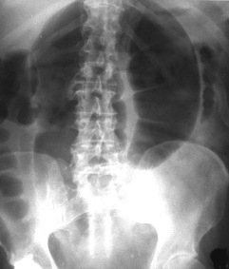
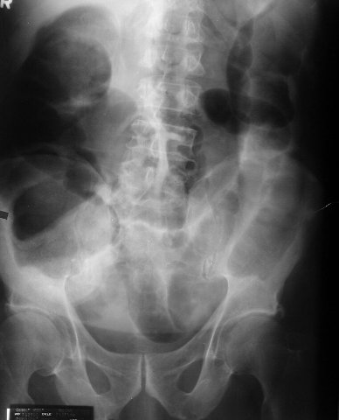
Sigmoid Volvulus
Colonic Obstruction

Slide 47
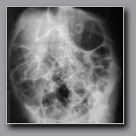
Ileus

